Slide 1
Module 3 Enhanced Security Administrative Forest
Section 2 - Dedicated Administrative Workstations
June 2018

Slide 2
Agenda
01
Why dedicated systems? Let’s have a closer look at the risks this is addressing.
05
Building and managing dedicated administrative workstations What do we need to provision such PAWs? How do we manage them? We will answer these questions in this part.
02
Hardware profiles There are two ways to deploy and use dedicated administrative systems and we will look at the pros and cons of each.
03
Three shades of PAWs Dedicated systems are not a monopoly of tier-o admins. There is also value in deploying them for other admins.
04
What about “jump servers”? Let’s see why these can be a very bad idea and how to use them in a secure manner.

Slide 3
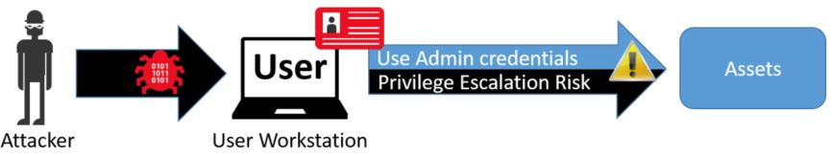
Why a dedicated administrative workstation?
Make the number one threat (credential theft) much harder
If the machine used by administrators is compromised, the attacker gets the keys to the kingdom right away
Principal of clean source
Administrative accounts input their password only from this machine
Credentials partitioning
Notes:
“Credentials partitioning” refers to the tier model seen in the previous module. Privileged accounts with tier-0 access should only be used on tier-0 machines. A dedicated administrative machine will be a part of the tier-0.
Ref: https://docs.microsoft.com/en-us/windows-server/identity/securing-privileged-access/privileged-access-workstations

Slide 4
Principal of clean source
Principal of clean source
Administrative accounts input their password only from this machine
Microsoft’s term for dedicated administrative machines is Privileged Access Workstations
PAWs can be members of a dedicated administrative forest if available
PAWs are disposable
Any doubt about its integrity? Rebuild
PAWs need a Trusted Platform Module chip
It enables additional security features
PAW
TPM
Notes:
What is a Privileged Access Workstation (PAW) mitigating:
Internet attacks – Most attacks originate directly or indirectly from internet sources and use the internet for exfiltration and command and control (C2). Isolating the PAW from the open internet is a key element to ensuring the PAW is not compromised.
Usability risk - If a PAW is too difficult to use for daily tasks, administrators will be motivated to create workarounds to make their jobs easier. Frequently, these workarounds open the administrative workstation and accounts to significant security risks, so it’s critical to involve and empower the PAW users to mitigate these usability issues securely. This is frequently accomplished by listening to their feedback, installing tools and scripts required to perform their jobs, and ensuring all administrative personnel are aware of why they need to use a PAW, what a PAW is, and how to use it correctly and successfully.
Environment risks – Because many other computers and accounts in the environment are exposed to internet risk directory or indirectly, a PAW must be protected against attacks from compromised assets in the production environment. This requires limiting the management tools and accounts that have access to the PAWs to the absolute minimum required to secure and monitor these specialized workstations.
Supply chain tampering - While it’s impossible to remove all possible risks of tampering in the supply chain for hardware and software, taking a few key actions can mitigate critical attack vectors that are readily available to attackers. This includes validating the integrity of all installation media and using a trusted and reputable supplier for hardware and software.
Physical attacks – Because PAWs can be physically mobile and used outside of physically secure facilities, they must be protected against attacks that leverage unauthorized physical access to the computer.

Slide 5
PAW hardening
No access to the internet
No access to emails
No access to LOB applications
No inbound traffic
Latest updates
Credential guard
App Locker/Code Integrity
Bitlocker
Notes:
Securing dedicated administrative workstations
Purpose-built hosts dedicated to IT administration
No Internet browsing from dedicated hosts
Allow network traffic to and from only authorized sources
No use of local computer administrative privileges for user
Exploit protection (authorized programs)
Automatic patching
Exploit Guard (Windows 10 build 1709)
Monitoring
Rapid re-provisioning of workstations

Slide 6
PAW hardware profiles
Dedicated hardware
Separate dedicated devices for user tasks vs. administrative tasks
Simultaneous Use
Single devices that can run user tasks and administrative tasks concurrently by taking advantage of OS or presentation virtualization
Profile | Pros | Cons
Dedicated hardware | Strong signal for sensitivity of tasks Strongest security separation | Additional desk space Additional weight (for remote work) Hardware Cost
Simultaneous Use | Lower hardware cost Single device experience | Sharing single keyboard/mouse creates risk of inadvertent errors/risks
Notes:
Dedicated Hardware
In this scenario, a PAW is used for administration that is completely separate from the PC that is used for daily activities like email, document editing, and development work. All administrative tools and applications are installed on the PAW and all productivity applications are installed on the standard user workstation. The step by step instructions in this guidance are based on this hardware profile.
Simultaneous Use - Adding a local user VM
In this simultaneous use scenario, a single PC is used for both administration tasks and daily activities like email, document editing, and development work. In this configuration, the user operating system is available while disconnected (for editing documents and working on locally cached email), but requires hardware and support processes that can accommodate this disconnected state.

Slide 7
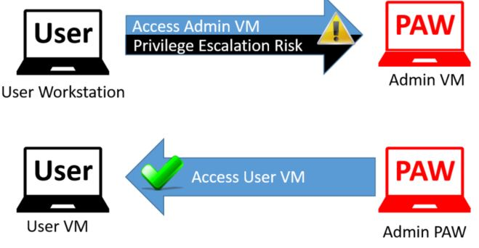

Simultaneous Use
Virtualization of the regular user workstation
And not the opposite!
Trusted source!
The physical hardware runs two operating systems locally
Admin OS - The physical host runs Windows 10 on the PAW host for Administrative tasks
User OS - A Windows 10 client Hyper-V virtual machine guest runs a corporate image
Admin OS
User OS
Notes:
With Windows 10Hyper-V, a guest virtual machine (also running Windows 10) can have a rich user experience including sound, video, and Internet communication applications such as Skype for Business.

Slide 8
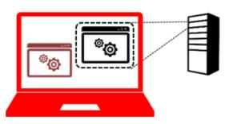
Simultaneous Use
Virtualization of the applications of the regular user
The “untrusted” applications are running remotely
This can use an existing Remote Desktop or VDI service (on-premises or in the cloud)
It is basically changing the paradigm of secondary-logons
Instead of connecting to your workstation and elevating your privilege to access administrative consoles, you connect to your PAW and “downgrade” your privilege to remotely run “untrusted” workloads
Notes:
Untrusted applications and workloads are the components of the environment with a connection to an untrusted network (like Internet). Because malwares, phishing and lateral movement generally take place on machines connected to the Internet, this dramality reduces the exposure of privileged credentials.
The Remote App option of the Remote Desktop Services is very user friendly as it looks like the applications is installed locally (it shows in the task bar and in the start menu) whereas they are effectively running remotely.
The physical hardware runs a single PAW operating system locally for administrative tasks and contacts a Microsoft or 3rd party remote desktop service for user applications such as email, document editing, and line of business applications.
In this configuration, daily work that does not require administrative privileges is done in the Remote OS(es) and applications which are not subject to restrictions applied to the PAW host. All administrative work is done on the Admin OS.
Information about Remote Apps: https://cloudblogs.microsoft.com/enterprisemobility/2009/06/08/introducing-remoteapp-and-desktop-connections/

Slide 9
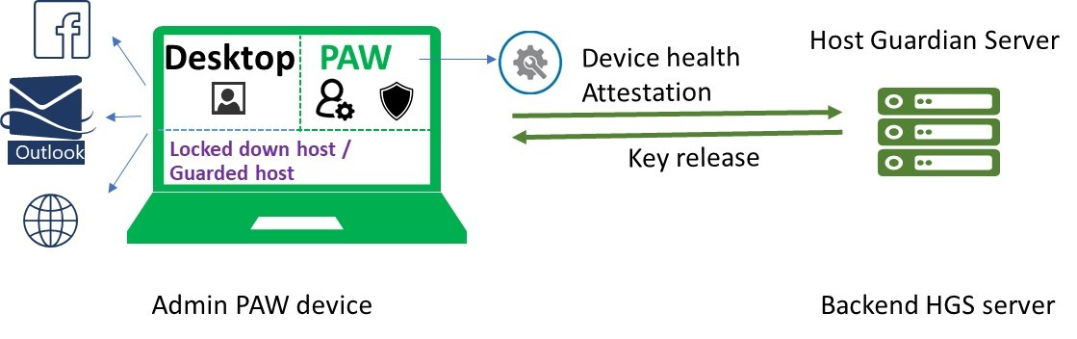
PAW at Microsoft
Starting Windows 10 1709 release
The physical machine is running Hyper-V with shielded-VM
The Host Guardian Server is ensuring the integrity of the VMs
Can host multiple PAWs for multi-profile or multi-forest environments
Notes:
This is how Microsoft is using PAW internally.
The PAW device is running the Windows 10 1709 release, which has a new feature: "Guarded host“. This feature supports the physical device performing remote health attestation against a Host Guardian Server (HGS) and running shielded VMs. In addition to the host remote health attestation, shielded VMs use a virtual TPM to encrypt data through Bitlocker. If the physical device is compromised, the virtual disks are encrypted and the attacker will either have to find a way to break BitLocker encryption or compromise the Host guardian service in the datacenter; neither is trivial.
Ref: https://blogs.technet.microsoft.com/datacentersecurity/2017/10/13/privileged-access-workstationpaw/
Video: https://myignite.microsoft.com/sessions/54896

Slide 10
Integrating PAWs
Ideally PAWs are domain-joined to a dedicated administrative forest or a PIM forest
Else, PAWs need a separate OU structure and a specific set of permissions in the production domain
Their own OU
Their own GPOs
What about remote workers?
If you need to go home with your PAW, make sure the firewall allows only connections to the VPN gateway when not connected to the corporate network
Notes:
The built-in firewall has three profiles that will be enabled automatically. The domain profile is selected when the machine has a line of sight with a domain controller.
The private/public profiles are set when the users are connected from elsewhere. For mobile workers, you would configure a rule enabled just for the private or public profiles allowing only to communicate with DNS servers and VPN services.

Slide 11
PAW and tiers
PAWs are not only for tier-0
PAWs in the tier-0 are the first one to be implemented and the most critical
PAWs can be deployed for tier-1 and tier-2 administration

Slide 12
PAW for tier-0
Notes:
Users, software and hardware that are equivalent in privilege to domain or enterprise administrators or have control over them are tier-0.
Tier 0 –
Direct Control of enterprise identities in the environment.
Tier 0 includes accounts, groups, and other assets that have direct or indirect administrative control of the Active Directory forest, domains, or domain controllers, and all the assets in it.
The security sensitivity of all Tier 0 assets is equivalent as they are all effectively in control of each other.

Slide 13
PAW for tier-1
Notes:
Tier 1 administrator accounts have administrative control of a significant amount of business value that is hosted on these assets. Control of enterprise servers and applications. Tier 1 assets include server operating systems, cloud services, and enterprise applications.
Tier 1 –
Control of enterprise servers and applications.
Tier 1 assets include server operating systems, cloud services, and enterprise applications.
Tier 1 administrator accounts have administrative control of a significant amount of business value that is hosted on these assets.
A common example role is server administrators who maintain these operating systems with the ability to impact all enterprise services.

Slide 14
PAW for tier-2
Notes:
Tier 2 administrator accounts have administrative control of a significant amount of business value that is hosted on these assets. Control of enterprise servers and applications. Tier 2 assets include server operating systems, cloud services, and enterprise applications.
Tier 2 –
Control of user workstations and devices.
Tier 2 administrator accounts have administrative control of a significant amount of business value that is hosted on user workstations and devices.
Examples include Help Desk and computer support administrators because they can impact the integrity of almost any user data.

Slide 15
How to generate the right OUs and GPOs?
PowerShell scripts are published to generate the logical structure
OU Structure
Groups
Delegations
Group Policy objects and links
Notes:
Download and reference: https://gallery.technet.microsoft.com/Privileged-Access-3d072563
Note that the package also contains firewall exceptions and proxy bypass list if the PAW machine needs to manage Azure cloud services or use some of the services for monitoring.

Slide 16
What about jump servers?
I don’t need a dedicated machine, I use a smartcard
I don’t need a dedicated machine, I use a jump server
Notes:
Smartcard is not a way to protect against pass the hash or pass the ticket. It protects only the acquirement of such (requires to know the PIN and have the card). Once they are obtained, the credentials are cached in memory like with other CPs.

Slide 17





Jumping servers are evil
If you access your jump server from your regular workstation, you are not improving your security posture
Pretty much all credential theft scenarios are still possible
User
Access Admin Applications
Object
Privilege Escalation Risk
Asset Control
Attacker
User Workstation
Admin
Jump Server
Access User Applications
Asset Control
Object
PAW
Attacker
User
Jump Server
Admin PAW
Notes:
A simple key-logger on your regular workstation will do the trick. And key logger can also run in user-mode, so even if your regular account is not a local administrator, it can still get you.

Slide 18
Taming the jumping servers
Jump servers are just a bad idea… Unless…
They can be used only from a PAW machine
You can install toolsets and other utilities for administrative duties
Access Admin Applications
Asset Control
Object
No Access
PAW
Attacker
Admin PAW
Admin
Jump Server
Notes:
Principal of clean-source. If you connect to your jump server from a PAW machine, you ensure that the input of credentials is still secured.
Remember credentials partitioning, the jump server is now a tier-0 machine

Slide 19
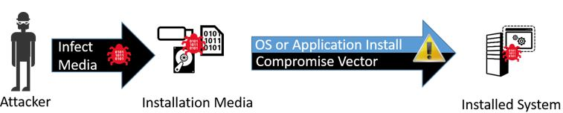
Building PAWs
Get a trusted ISO
Directly from Microsoft
Download and check integrity
Automate the deployment to make it easy to re-deploy
Deploy a Microsoft Deployment Toolkit server to distribute the image
The MDT can be managed by tier-0 admins
Use the secure baselines for Windows 10 a GPO template
Baselines were dealt with in the previous module
Notes:
Applying the clean source principle to installation media requires you to ensure that the installation media has not been tampered with since being released by the manufacturer (as best you are able to determine).
The source of the software should be validated through one of the following means:
Software is obtained from physical media that is known to come from the manufacturer or a reputable source, typically manufactured media shipped from a vendor.
Software is obtained from the Internet and validated with vendor-provided file hashes.
Software is obtained from the Internet and validated by downloading and comparing two independent copies:
Download to two hosts with no security relationship (not in the same domain and not managed by the same tools), preferably from separate Internet connections.
Compare the downloaded files using a utility like certutil: certutil -hashfile <filename>
What Is the MDT?
Set of tools to automate the deployment of Windows operating systems (Windows 7 and newer operating systems, including Windows Server 2012 R2).
You may use Microsoft Deployment Toolkit (MDT) or another automated image deployment system to automate PAW deployment, but you must ensure the build process is as trustworthy as the PAW. Adversaries specifically seek out corporate images and deployment systems (including ISOs, deployment packages, etc.) as a persistence mechanism so preexisting deployment systems or images should not be used.
If you automate deployment of the PAW, you must:
Build the system using installation media
Ensure that the automated deployment system is disconnected from the network during the operating system build process.

Slide 20
Managing and updating PAWs
Approach | Considerations
Default Windows Server Updates Services Windows Defender | No additional cost Performs basic required security functions
Manage with Intune | Provides cloud based visibility and control No server infrastructure
Manage PAWs with existing management tools | Creates significant risk to compromise of PAWs unless the existing management infrastructure is brought up to security level of PAWs
Notes:
PAWs must have anti-malware capabilities and software updates must be rapidly applied to maintain integrity of these workstations.
Manage with Intune
Provides cloud based visibility and control
Software Deployment
Manage software updates
Windows Firewall policy management
Anti-malware protection
Remote assistance
Software license management.
No server infrastructure required
Requires following "Enable Connectivity to Cloud Services" steps in Phase 2
If the PAW computer is not joined to a domain, this requires applying the SCM baselines to the local images using the tools provided in the security baseline download.
Note there might be license cost with the usage of Intune.
Manage PAWs with existing management tools
Microsoft would generally discourage this approach unless your organization has a specific reason to use it. In our experience, there is typically a very high cost of bringing all of these tools (and their security dependencies) up to the security level of the PAWs.
Most of these tools provide visibility and control of configuration, software deployment, and security updates

Slide 21
Monitoring PAWs
SIEM
If not agentless, then the SIEM infrastructure needs to be on the same tier as the PAWs
Windows Event Forwarding
Provides an agentless method of forwarding security events from the PAWs to an external collector or SIEM
Can access events on PAWs without administrative access
Does not require opening up network ports to allow inbound traffic from the SIEM servers
Azure Security Center integration
For event collection and threat detection
Windows Defender ATP
Notes:
Windows Defender Advanced Threat Protection (ATP) is a unified platform for preventative protection, post-breach detection, automated investigation, and response.
Watch the introduction video for Windows Defender ATP here: https://www.microsoft.com/en-us/windowsforbusiness/windows-atp

Slide 23
List of abbreviations
PAW Privileged Access Workstations
TPM Trusted Module Platform
HGS Host Guardian Server
MDT Microsoft Deployment Toolkit

